Slide 1

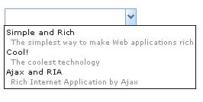
Combobox
span.combobox
span. rbtnbk
div.comboboxpp
.comboboxpp td
.comboboxpp td span
Notes:
<%-- Combobox and Datebox --%>
span.combobox, span.datebox, span.bandbox {
border: 0; padding: 0; margin: 0; white-space: nowrap;
}
span.rbtnbk {<%-- button at the right edge --%>
background-image: url(${c:encodeURL('~./zul/img/btnbk.gif')}); background-repeat: no-repeat;
border: 1px solid #7f9db9; border-left: none;
}
div.comboboxpp, div.bandboxpp {<%--hardcoded in DSP--%>
display: block; position: absolute; z-index: 88000;
background: white; border: 1px solid black; padding: 2px;
font-size: x-small;
}
div.comboboxpp {
overflow: auto; <%-- if bandboxpp overflow:auto, crop popup if any --%>
}
.comboboxpp td {<%--label--%>
white-space: nowrap; font-size: x-small; cursor: pointer;
}
.comboboxpp td span {<%--description--%>
color: #888; font-size: xx-small; padding-left: 6px;
}

Slide 2

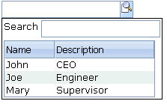
Bandbox
span.bandbox
div.bandboxpp

Slide 3
Checkbox
input

Slide 4
Button
button

Slide 5

Caption
td.caption
.caption a
.caption input
.caption button

